Slide 1

Data Structures and Algorithms Odd Semester 2022
^{5th} Semester , ECE
Jaypee Institute Of Information Technology (JIIT), Noida

Slide 2
Outline
Review of Singly linked list

Slide 3

Linked list is a linear data structure which is made up of nodes connected together by pointers.
Each node has two main parts :
Data - contains the data/value to be stored
Link – contains address of the next node.
Each Node in a Linked List is created Dynamically.
A head or start pointer is used to keep track of the starting of linked list.

Slide 4
Basic Operations on a List
The basic operations on linked lists are as follows:
1. Initialize the list.
2. Determine whether the list is empty.
3. Print the list.
4. Find the length of the list.
5. Destroy the list.
6.Retrieve the info contained in the first node.
7. Retrieve the info contained in the last node.
8. Search the list for a given item.
9. Insert an item in the list.
10. Delete an item from the list.
11. Make a copy of the linked list.

Slide 5
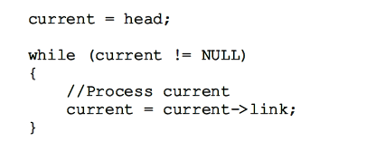
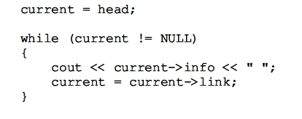
TRAVERSING A LINKED LIST
Print A LINKED LIST

Slide 6
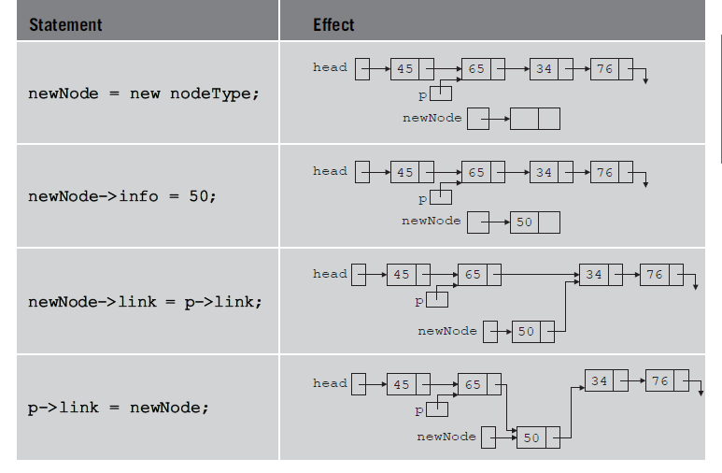


Item Insertion and Deletion
Linked list before insertion
Suppose a new node with info 50 is to be created and inserted after p.
create newNode
store 50 in the new node
Make newNode->link point to the p->link
Make p->link point to newNode

Slide 7


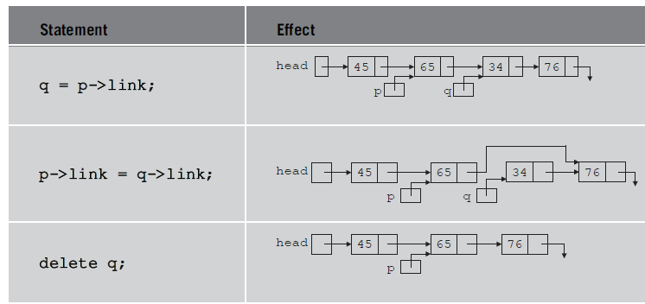
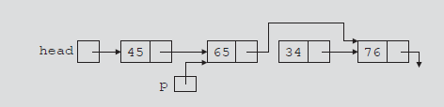
Deletion
Node to be deleted is with info 34
p->link = p->link->link;

Slide 8



Building a Linked List
Suppose that the nodes are in the usual info-link form and info is of type int.
Create a linked list with following data:
2 15 8 24 34
//the first points to the first node in the list. Initially, the list is empty, so both first and last are NULL. Thus, we must have the statements

Slide 9
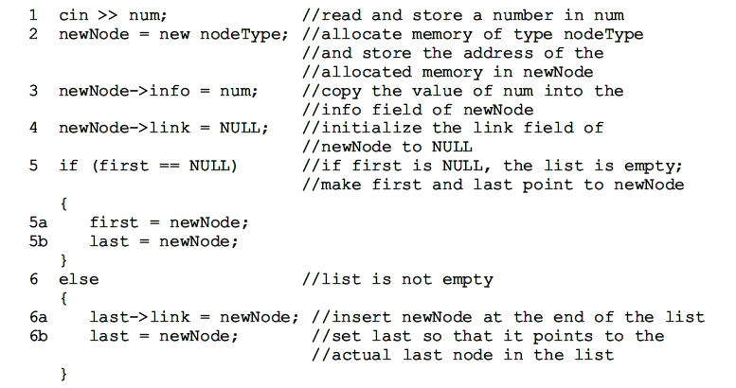

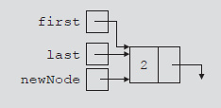

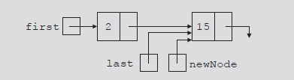
Create a linked list with following data:
2 15 8 24 34
List and newNode with info 15
List after inserting newNode at the end

Slide 10
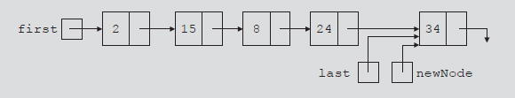
List after inserting 8, 24, and 34

Slide 11
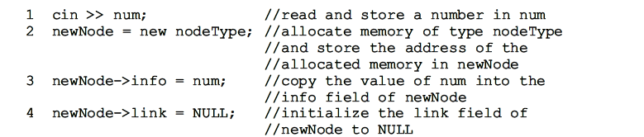

Slide 12
References
https://www.hackerearth.com/practice/notes/stacks-and-queues/
https://www.softwaretestinghelp.com/stacks-and-queues-in-stl/
https://www.geeksforgeeks.org/forward_listclear-forward_listerase_after-c-stl/

